Slide 1
Topic – OOPs In Java
Presented by :
Priyanka
Amruta
Shweta
Faizan

Slide 2
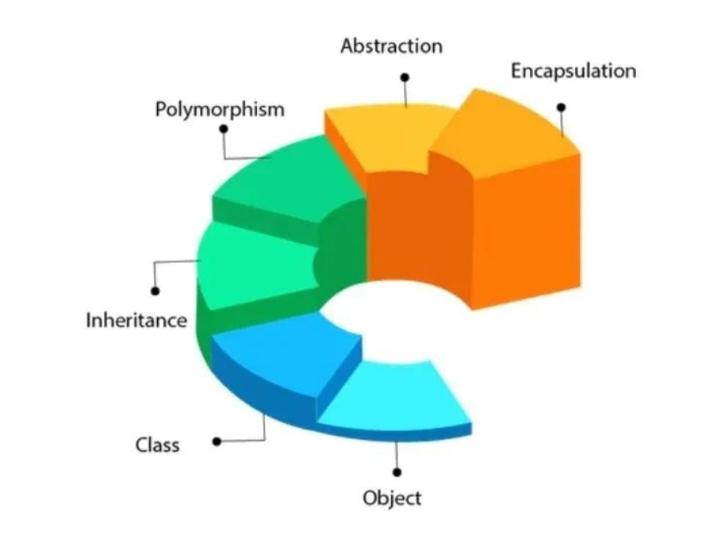
00Ps IN JAVA
What is OOPs ?
Object oriented programming is a methodology to design a program using
classes and objects.
It simplifies software development.
Pillars of OOPs in Java
Object
Class
Inheritance
Polymorphism
Abstraction
Encapsulation

Slide 3
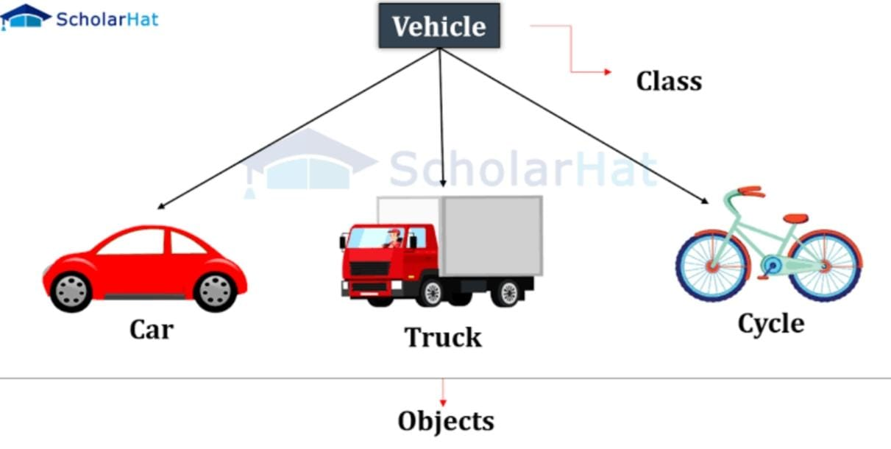
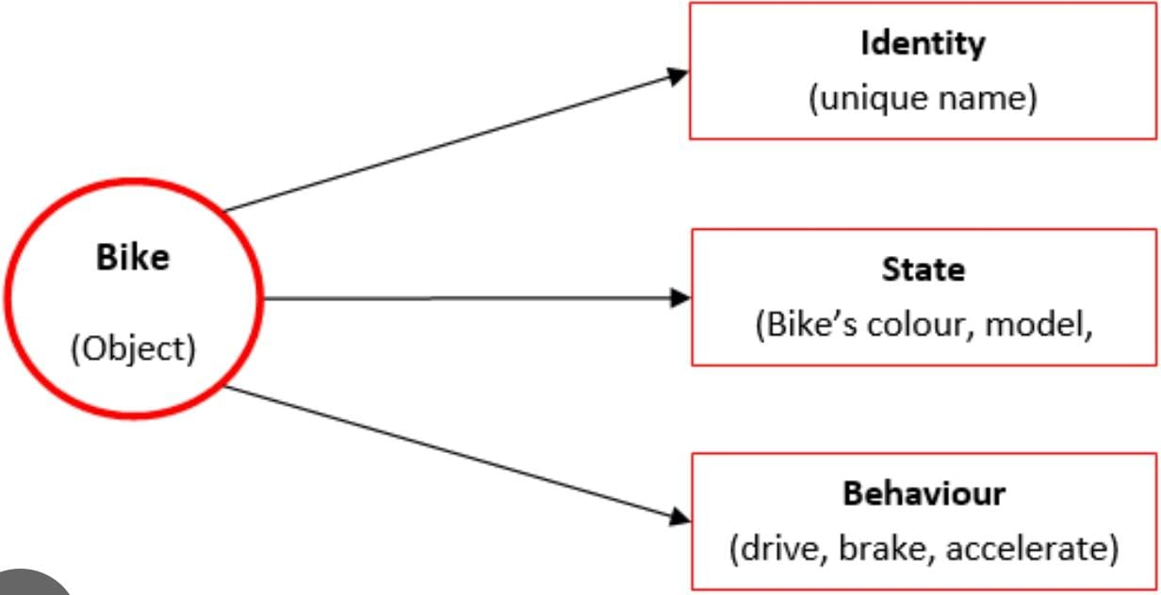
1. Object In Java
An object can be represented as an entity that has state and behaviour.
An object is a instance of a class and there can be multiple instances of a class.
It is a physical entity which contains an address and consumes space in memory.
Syntax – ClassName obj = new ClassName();

Slide 4
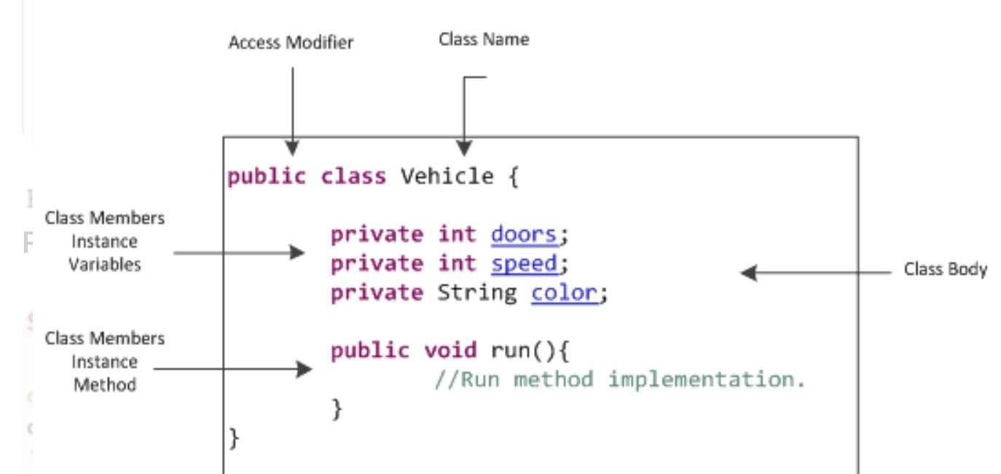
2. Class In Java
Class is a collection of a multiple entities such as methods, variables, datatypes and constructors etc..
It is a set of instructions which is used to build a specific type of object.
It is a logical entity which doesn’t consumes space in a memory.

Slide 5
3. Inheritance in Java
It is a mechanism in which one class acquires all the properties from another class with the help extends keyword.
So, Inheritance establish the relationship between two classes using extends keyword for code reusability.
Syntax : public class SubclassName extends SuperClassName { }
Types of Inheritance
Single level Inheritance
Multi level Inheritance
Multiple Inheritance
Hierarchical Inheritance
Hybrid Inheritance
Superclass
Super class / base / parent
extends
Subclass
Sub class / derived / child

Slide 6
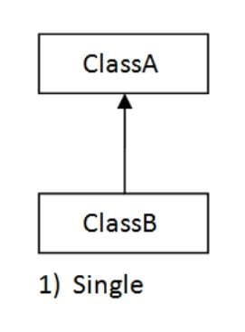
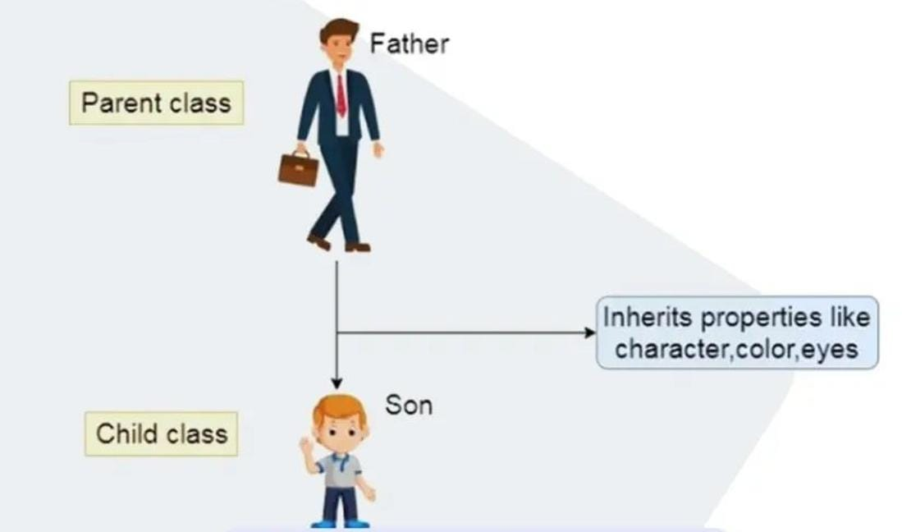
Single level inheritance
It is a operation where inheritance takes place between two classes only is known as Single level inheritance.
Here subclass acquires all the properties of superclass by using extends keyword.
Superclass
extends
Subclass

Slide 7
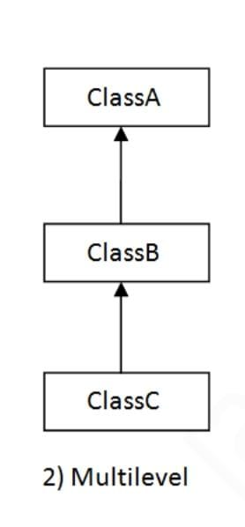
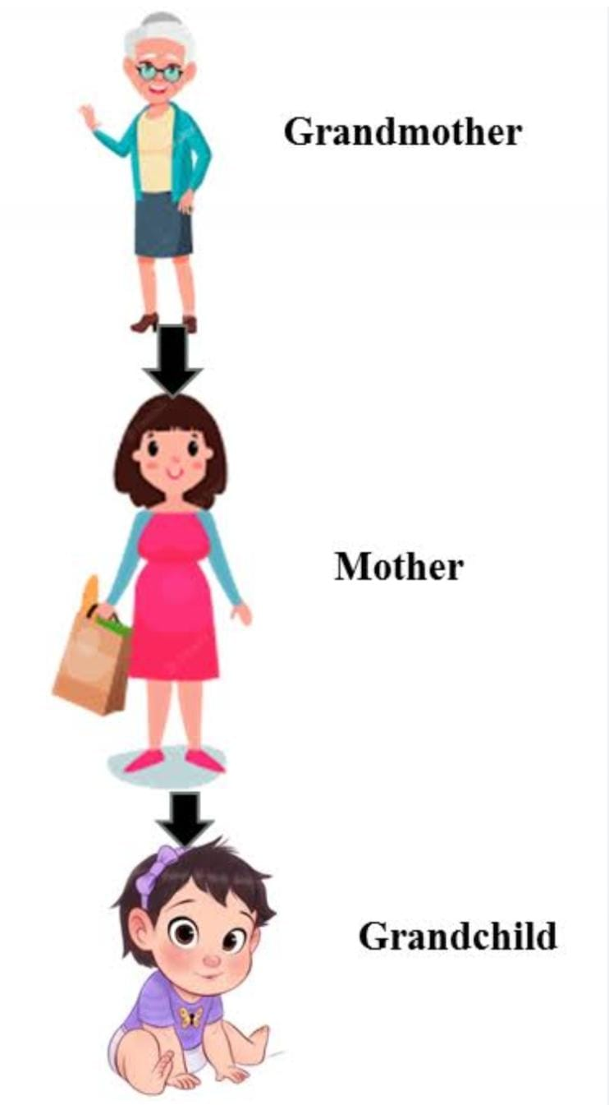
Multilevel inheritance
It is a operation where inheritance takes place between three or more classes is known as multilevel inheritance.
Here one subclass acquires all the properties of superclass by using extends keyword and this phenomenon continues, so there is a chain of inheritance.
Superclass
extends
Subclass 1
extends
Subclass 2

Slide 8
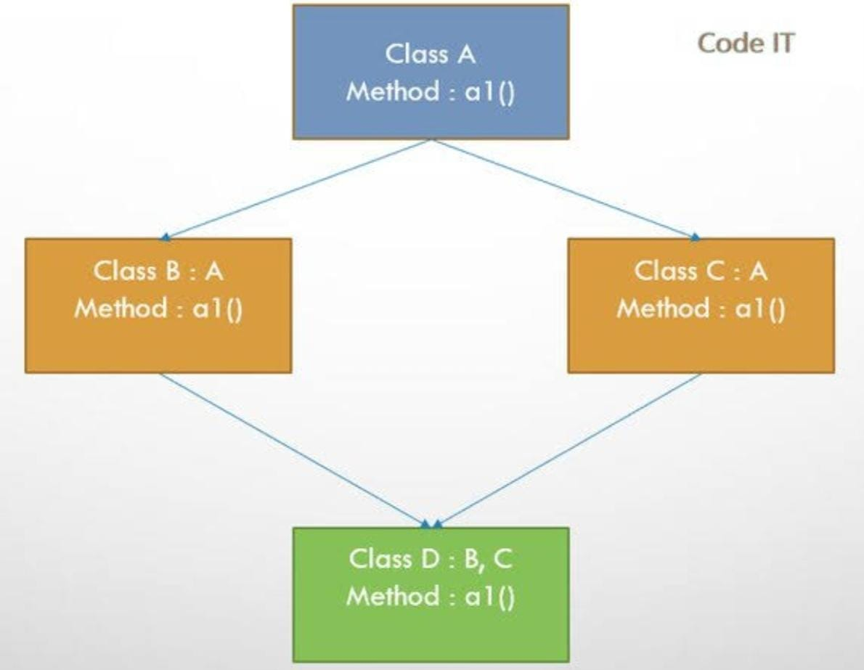
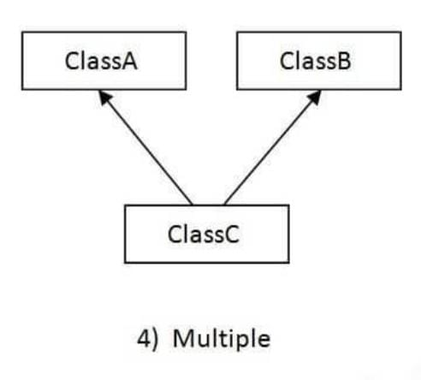
Multiple inheritance
It is a process of inheritance in which one subclass acquires all properties from two or more super classes at the same time with the help of extends keyword is known as multiple inheritance.
But Java doesn’t support multiple inheritance because it results diamond ambiguity problem.
Superclass
Superclass
extends
Subclass

Slide 9
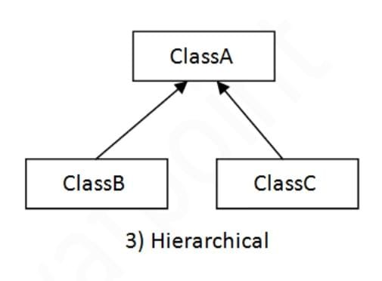
Hierarchical inheritance
It is a process of inheritance where multiple subclasses acquires all the properties from one super class with the help of extends keyword is known as hierarchical inheritance.
Here two or more classes inherits a single class.
Superclass
extends
Subclass
Subclass

Slide 10
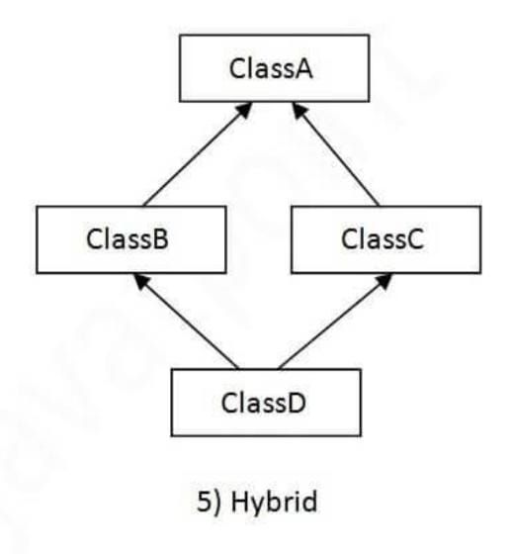
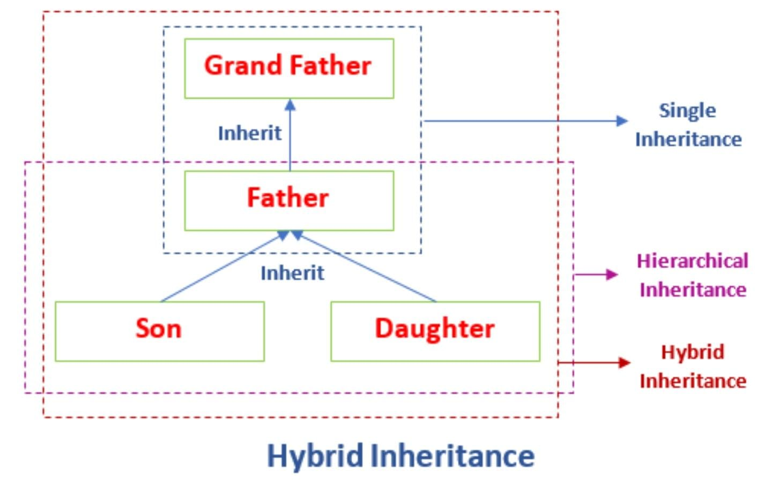
Hybrid inheritance
It is a process of combining more than one type of inheritance together.
But Java doesn’t support hybrid inheritance because it results diamond ambiguity problem.
But we can achieve multiple and hybrid inheritance by using Interfaces.

Slide 11
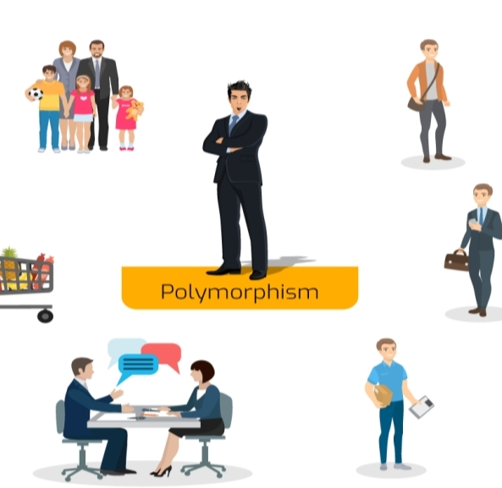
4.Polymorphism In java
Polymorphism means “Many Forms”
It is a concept by which we can perform a single action in a different way.
It occurs when we have many classes that are related to each other by inheritance.
For example: A Person at the same time can have a different characteristics.
Like a man at the same time is a father, A husband, an employee. so, the same person possesses different behavior in different situations. This is called Polymorphism.

Slide 12
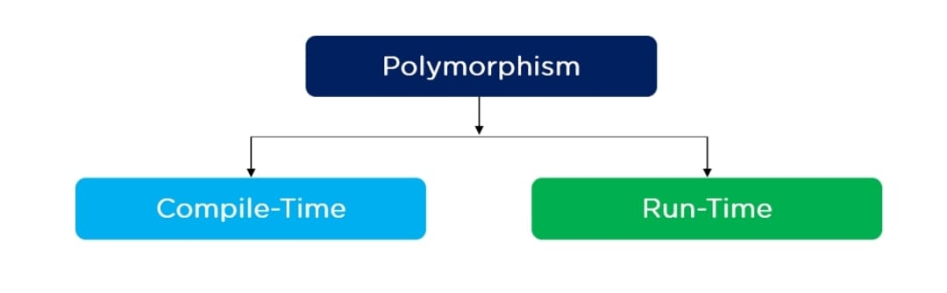
Types of Polymorphism
There are two types of polymorphism in Java
Compile time Polymorphism
Run time polymorphism

Slide 13
Compile Time
The process of polymorphism which takes place during compile time is known as compile time polymorphism.
This process takes place inside a same class only.
It is also known as early binding or static binding.
Example-
Method overloading-
In a class we have multiple methods having same name but different parameter or argument, it is known as Method overloading.

Slide 14
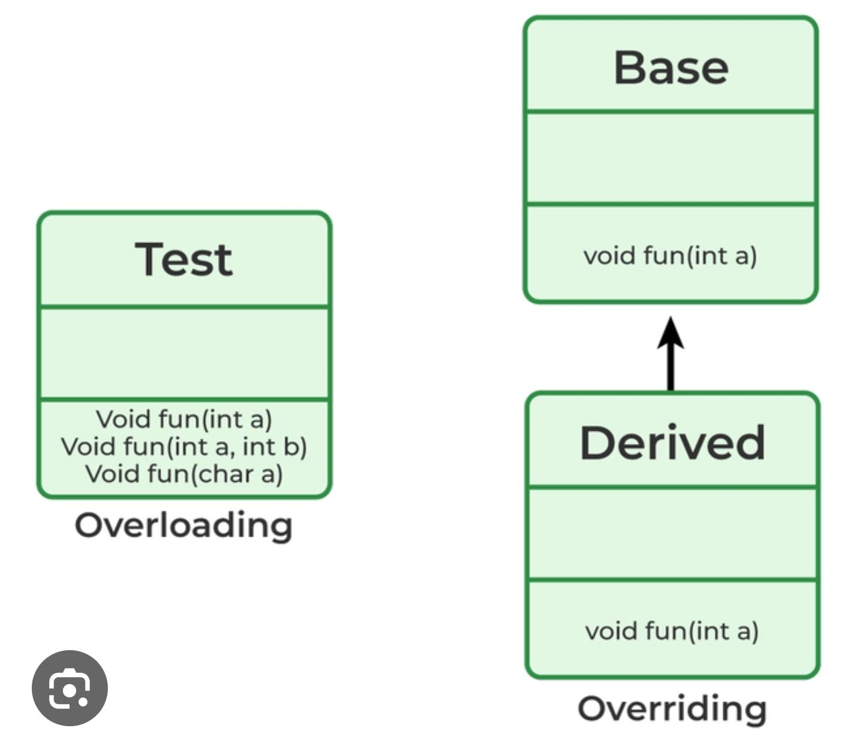
2. Runtime Polymorphism
The process of polymorphism which takes place during run time or execution is known as run time polymorphism.
It is also known as a Dynamic / Late binding.
Example-
Method overriding-
In a different classes if we have multiple methods having same name and same argument, and having inheritance relationship between these two classes. Then it is known as Method overriding.

Slide 15
Difference between method overloading and method overriding
Method overloading
Method overriding
1.It is used to increase the readability of the program.
2.It occurred with the class.
3.It is an example of compile time polymorphism.
4.Parameters must be different.
1.It is used to provide the specific implementation of the method that is already provided by its super class.
2.It occurred in two classes inheritance relationship.
3.It is an example of run time polymorphism.
4.parameters must be same.

Slide 16


5. Abstraction in Java
What is Abstraction?
An Abstraction is a process of hiding the information /implementation/code and showing only the functionality to the end users.
Ex. ATM machine, sending an SMS, Driving a Car

Slide 17
Ways to Achieve Abstraction:
1.Abstract Class
With the help of Abstract class we can achieve 1 to 100% abstraction.
2.Interface
With Interface we can achieve 100% Abstraction

Slide 18
Abstract Class:
A class which is declared with Abstract Keyword is called as Abstract Class.
syntax: public abstract class ClassName { }
It contains Abstract method and non- Abstract method.
syntax for abstract method: public abstract void methodName();
It can’t be instanciated i.e. we cannot create an object of Abstract class.
It can have Constructor and static method as well.
Final method are not allowed as it is going to implement.

Slide 19
Concrete class:
Abstract class
A concrete class is a class which is responsible to implement all the abstract methods from Abstract Class.
A concrete class will have method body for the abstract methods from abstract class.
Extends
Concrete class

Slide 20
Interface:
Definition : Interface is a blueprint of a class , which is used to achieve Abstraction and multiple inheritance.
Syntax: public interface InterfaceName { }
Data members i.e. variables declared inside interface have by default - public , static, final keywords.
-syntax: int a=10;
Methods declared inside interface have by default-public abstract keywords.
-syntax: void methodName();
Object of interface cannot be created.
Interface cannot have constructor.
Interface supports multiple inheritance.

Slide 21
Implementation class:
A class which is responsible to implement all the Abstract methods from Interface is known as Implementation class.
This class will have the method body for the Abstract methods from interface.
It supports multiple inheritance means we can implement abstract methods from two or more than two interfaces.
Interface1
Interface2
Interface3
Implements
Implementation class

Slide 22
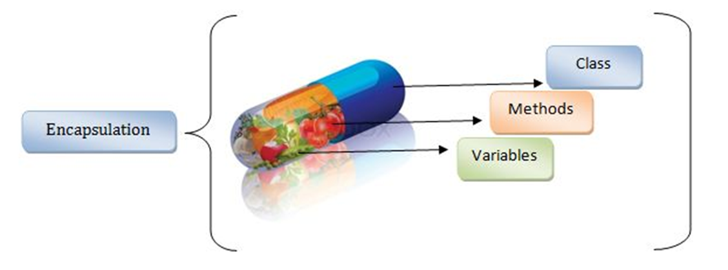
6. Encapsulation
The process of wrapping the data and corresponding methods into a single unit is called as an Encapsulation.
Example: Medicine capsule, School Bag.
So, if any component follows data hiding and abstraction then it is called encapsulation.
How To achieve Encapsulation ?
Declare variable of a class as private.
Provide public getters and setters methods to modify and view the variable value.
Syntax - private datatype variable = info ;
example – private int x = 10 ;
.

Slide 23
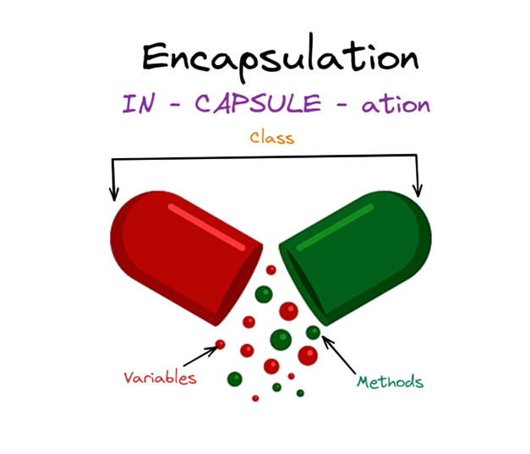
Few points about encapsulation
User would never know of what is going on in the background, they would be only aware of update the field by set method and read a field by get method.
Set and get words used in the method names are only for naming purpose so that programmer should understand which is set and get method.
Advantages :
It is easy to test.
It is better for unit testing.
It provides security.

Slide 24
THANK YOU !

